Slide 1


Private Higher School of Engineering And Technology
(ESPRIT)
GRADUATION PROJECT
NATIONAL ENGINEERING DEGREE
Migration from a monolith architecture to a micro-service
architecture & establishment of a financial portals
management platform
By : AMIN JELLALI
Corporate Internship Supervisor: Mr. HICHEM ELLOUMI
Academic supervisor : Mr. LOTFI NCIB
College Year:
2018-2019
Notes:
Context de la présentation

Slide 2
Summary
Presentation of MINOTORE
State of the art
Problematic
Study and critics of the existing
Proposed solution
Methodology and work environment
ETL
Product API
Comparator Widget
Integration
Conclusion and perspectives
References

Slide 3

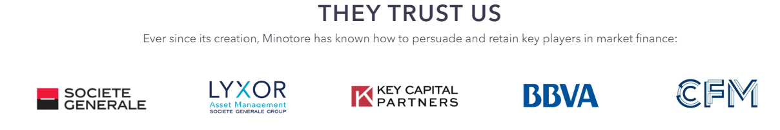
Presentation of MINOTORE
Who is Minotore?
Founded in 2013 by traders and financial engineers from the largest European banking groups.
Offering services to some of the biggest European banks like BNP Paribas, Natixis and Societe Generale ...

Slide 4
Presentation of MINOTORE
What does Minotore do ?
Digital platforms :
Digital platforms for financial institutions.
Tailor-made digital solutions for financial markets.
Finance work-flows.
Animations:
Institutional videos and creation of animated content.
Tactical solutions :
Custom made and fast tactical solutions
Creation of POCs, testing and clients ideas validation.
Consulting.

Slide 5
State of the art
Financial market
Financial products
Financial portals
Minotore definition of a financial product
Notes:
Ref photo

Slide 6
State of the art – Financial market
Financial Market
Money
Market
Capital Market
Organized
OTC
Primary Market
Secondary Market
Notes:
Ref photo

Slide 7
State of the art – Financial products
Commodities
Agricultural (Cocoa, corn)
Metal(gold, silver)
Energy (oil and gaz)
Derivatives
Options
Forwards
Equity
Stocks
Fixed Income
Bonds
Treasury bills
Structured Products
ETF
Money
Currencies
Notes:
Ref photo

Slide 8
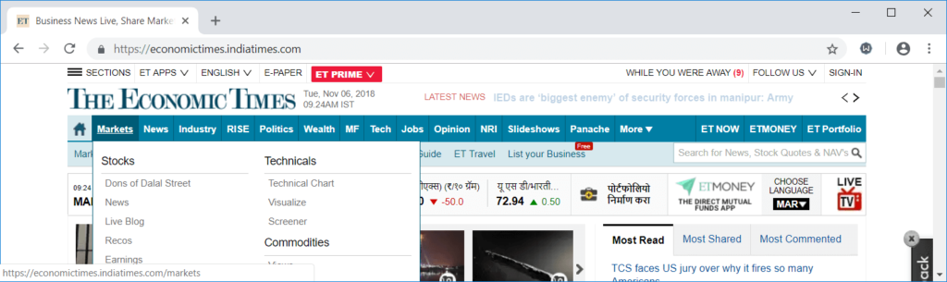
State of the art – Financial portals
A picture presents THE ECONOMIC TIMES Financial portal
Notes:
Ref photo

Slide 9
State of the art – Minotore financial product
Product Identifier
Context and visibility
Passporting countries
Characteristics
Metrics
Historical
data
Compositions
Breakdowns
Currencies
Notes:
Ref photo

Slide 10

Problematic
Notes:
Ref photo

Slide 11
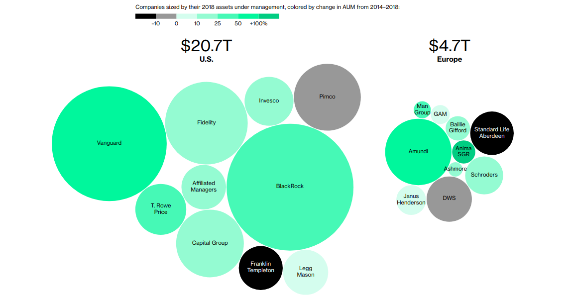
Problematic
AM market in numbers provided by bloomberg
Notes:
Ref photo

Slide 12
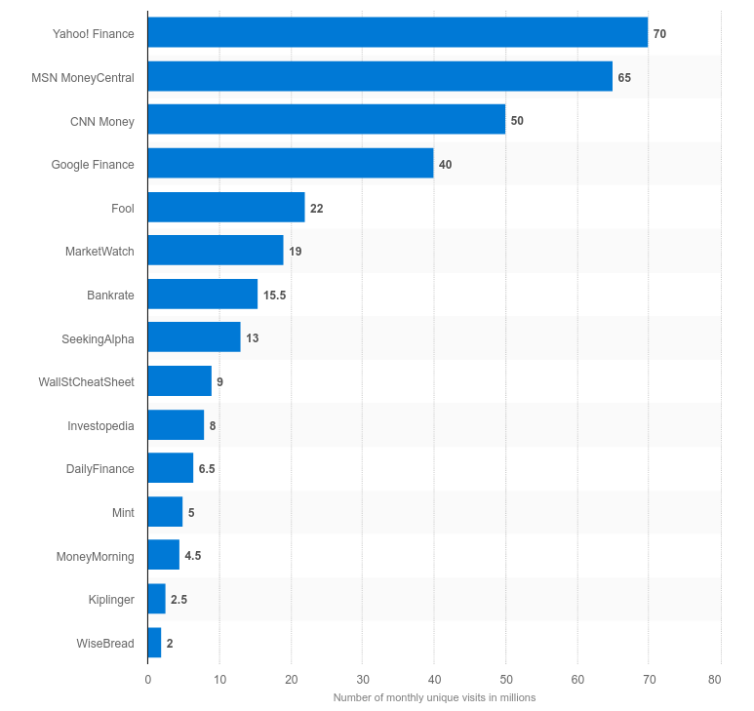
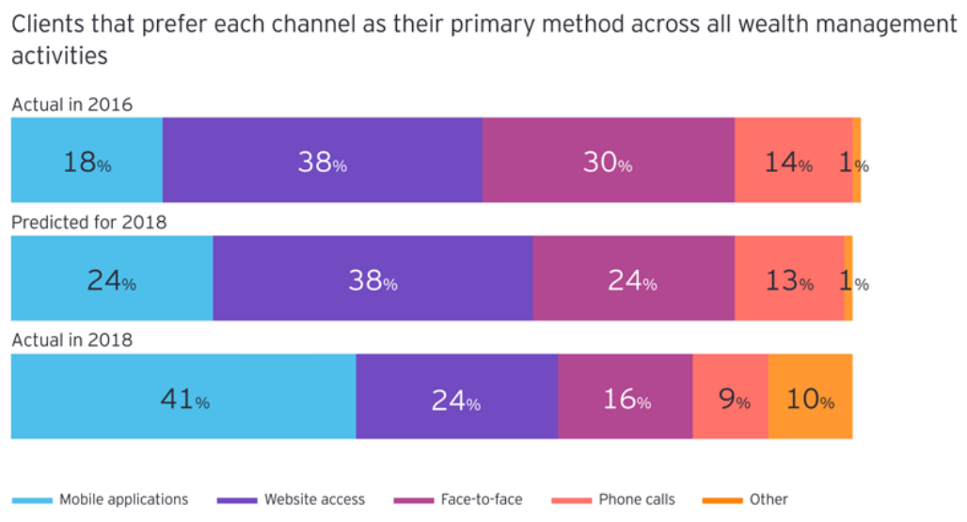
Problematic
Statistics of AM clients communication preferences provided by EY
Monthly visits of the financial portals
Notes:
Ref photo

Slide 13
Study and critics of the existing
Lyxor ETF
Investing.com
Ishares
Notes:
Ref photo

Slide 14
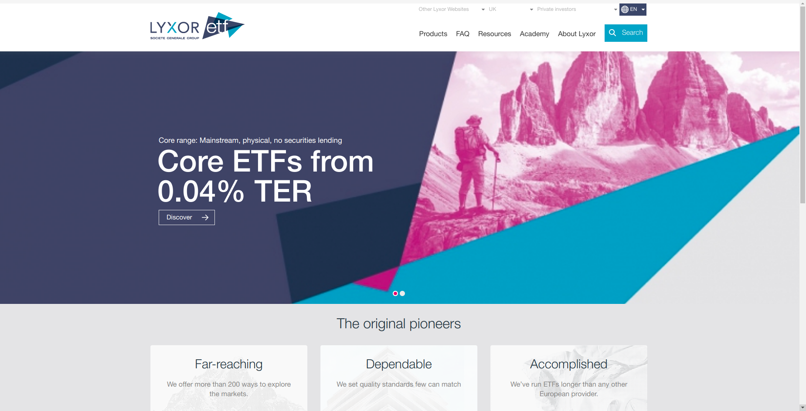
Study and critics of the existing
LYXOR ETF
Highly customized.
Manged via a content management system.
Supports multiple languages.
Not scalable.
Difficult to maintain.
Could only be used by LYXOR.
Notes:
Ref photo

Slide 15
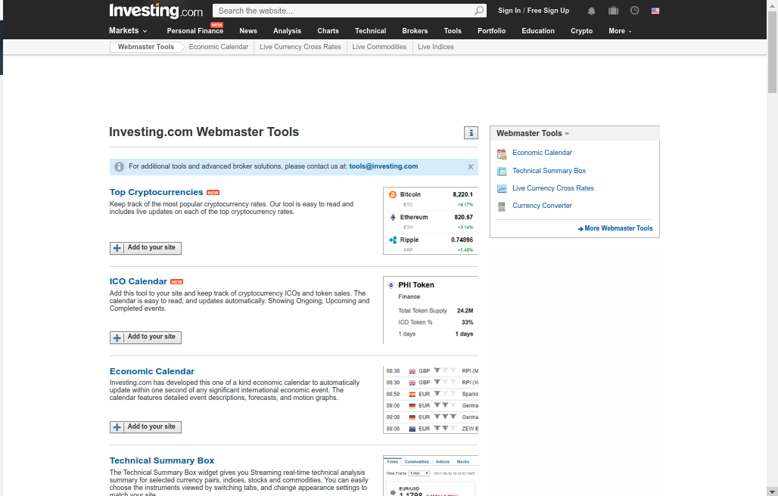
Study and critics of the existing
Investing.com
Supports multiple languages
Provides configurable and exportable financial widgets.
Could not be customized or branded.
The widgets could not adapt to the hosting websites theme
Notes:
Ref photo

Slide 16
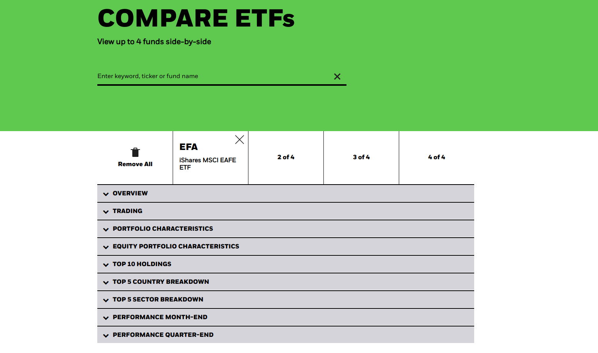
Study and critics of the existing
Ishares
Configurable comparator (one of the most demanded apps)
Configurations are complex and require tech intervention.
Has no graphical comparison tools.
Notes:
Ref photo

Slide 17
Proposed solution
Minotore platform
Minotore Widgets
Notes:
Ref photo

Slide 18
Proposed solution
Minotore platform
Products management System:
ETL micro-service
Products micro-service
Translate micro-service
Web site content management System:
CMS
Content rendering micro-service
Widgets management System:
Widget API
Products micro-service
Translate micro-service
Notes:
Ref photo

Slide 19
Proposed solution
Minotore widgets
A set of configurable elementary web components that could be added to any web-site via the CMS
Notes:
Ref photo

Slide 20
Methodology and work environment
SCRUM
Planning
Work environment
Notes:
Ref photo

Slide 21
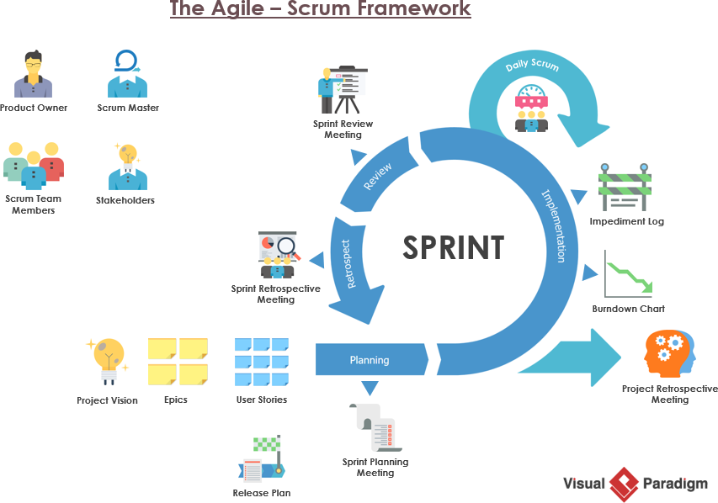
Methodology and work environment
Notes:
Ref photo

Slide 22
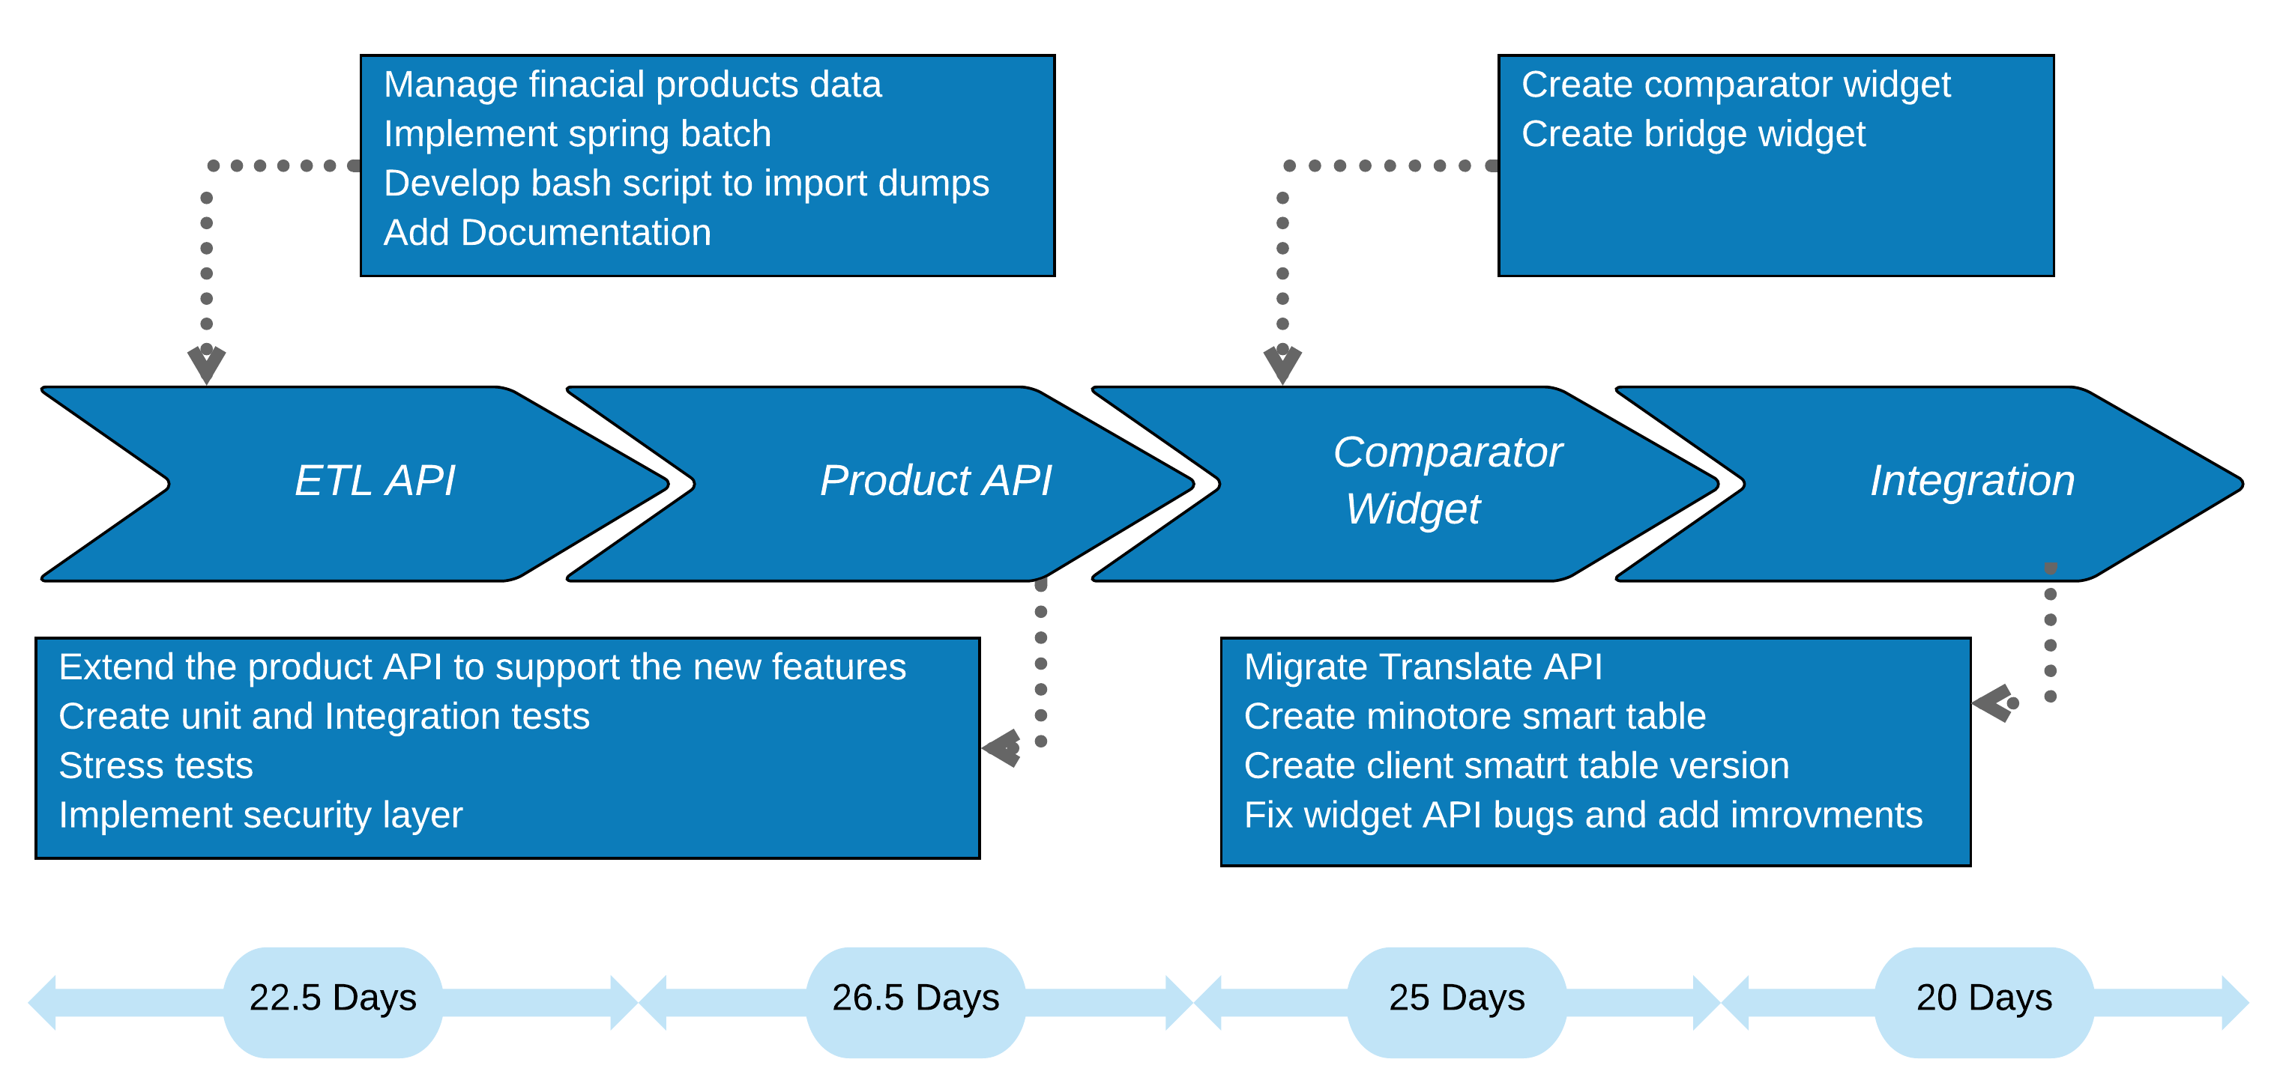
Methodology and work environment
Notes:
Ref photo

Slide 23










Methodology and work environment
Back-end
Front-end
Data bases
Notes:
Ref photo

Slide 24
ETL micro-service
Use case
Non functional requirements
Realisation
Notes:
Ref photo

Slide 25
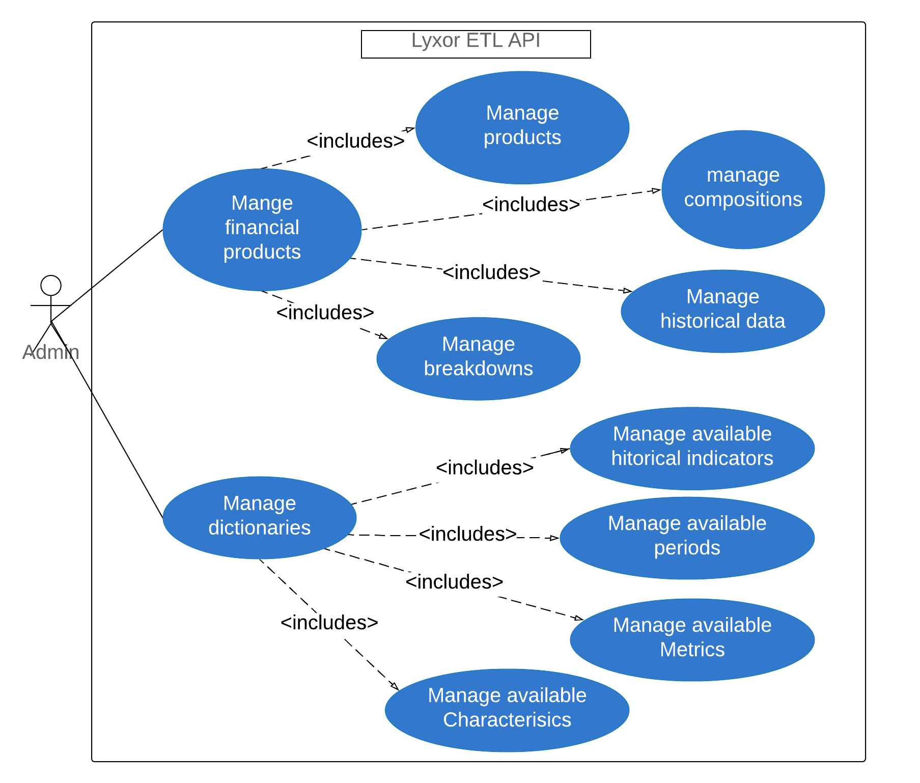
ETL micro-service
Notes:
Ref photo

Slide 26
ETL micro-service
Rapid Responses
Robust
Non Functional requirements
Documentation
Configuration
Notes:
Ref photo

Slide 27
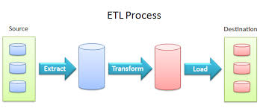
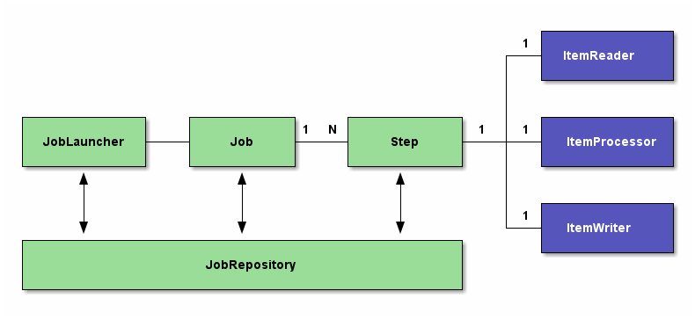
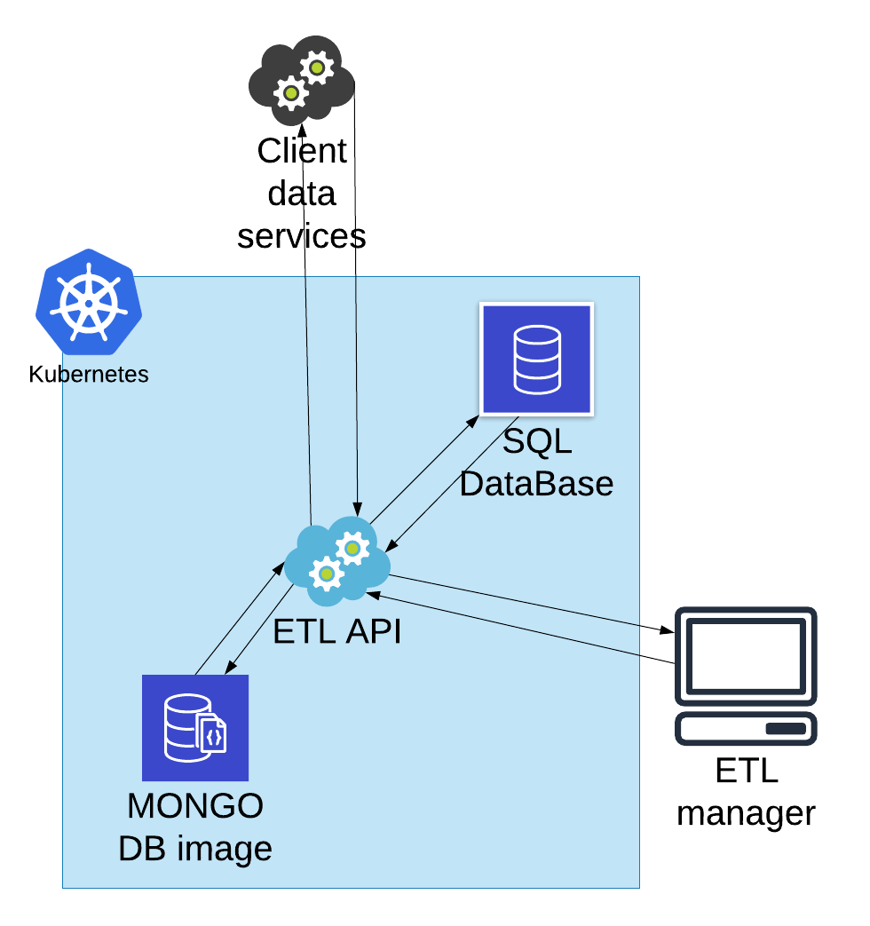
ETL micro-service
Notes:
Ref photo

Slide 28
Products micro-service
Use case
Non functional requirements
Realisation
Notes:
Ref photo

Slide 29
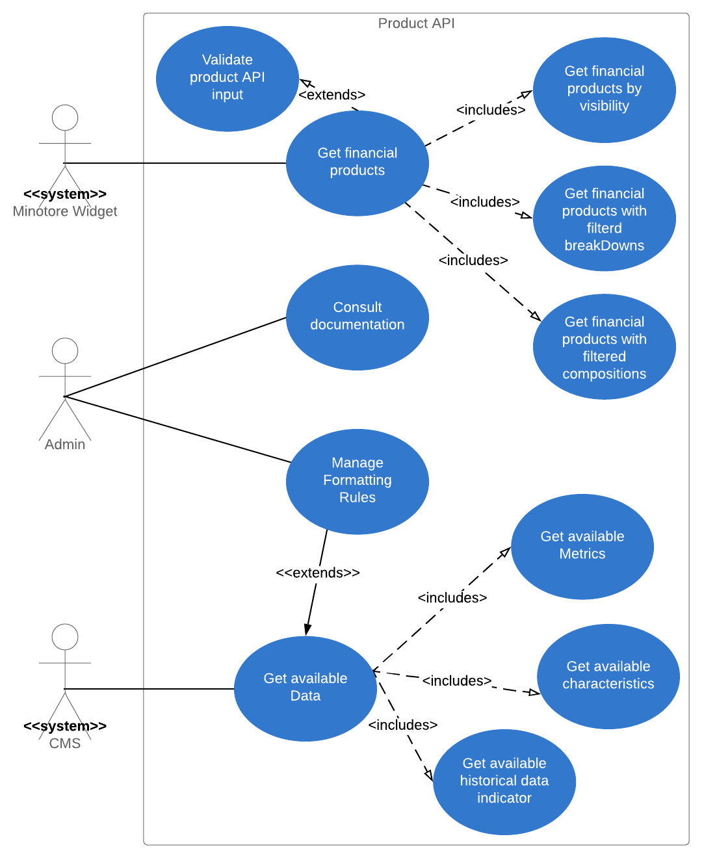
Products micro-service
Notes:
Ref photo

Slide 30
Products micro-service
Rapid Responses
Robust
Non Functional requirements
Security
Documentation
Configuration
Notes:
Ref photo

Slide 31
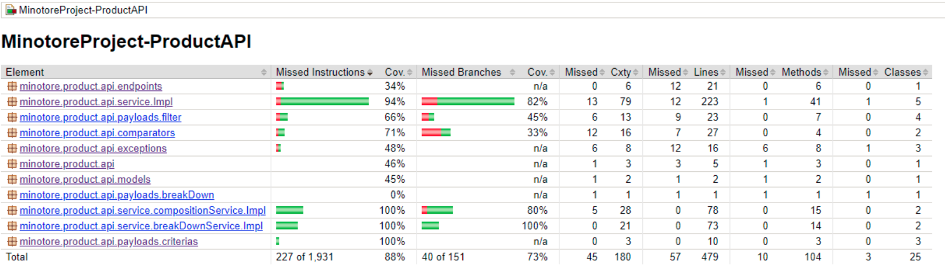
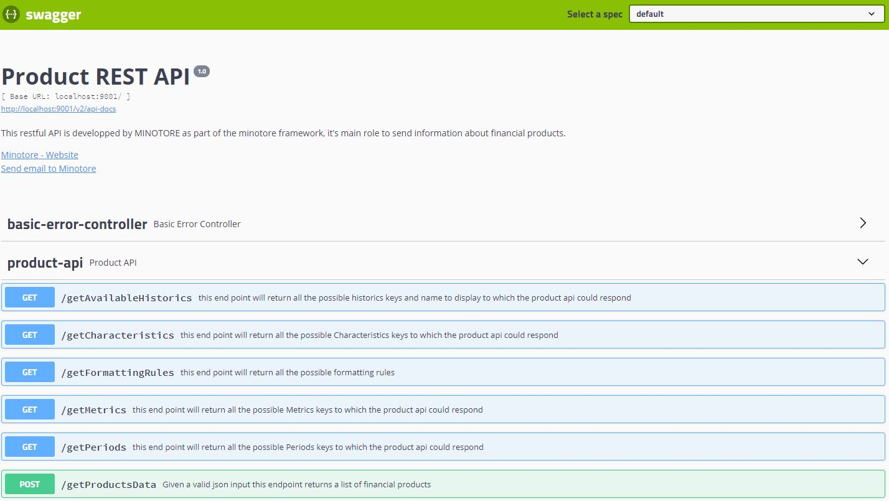
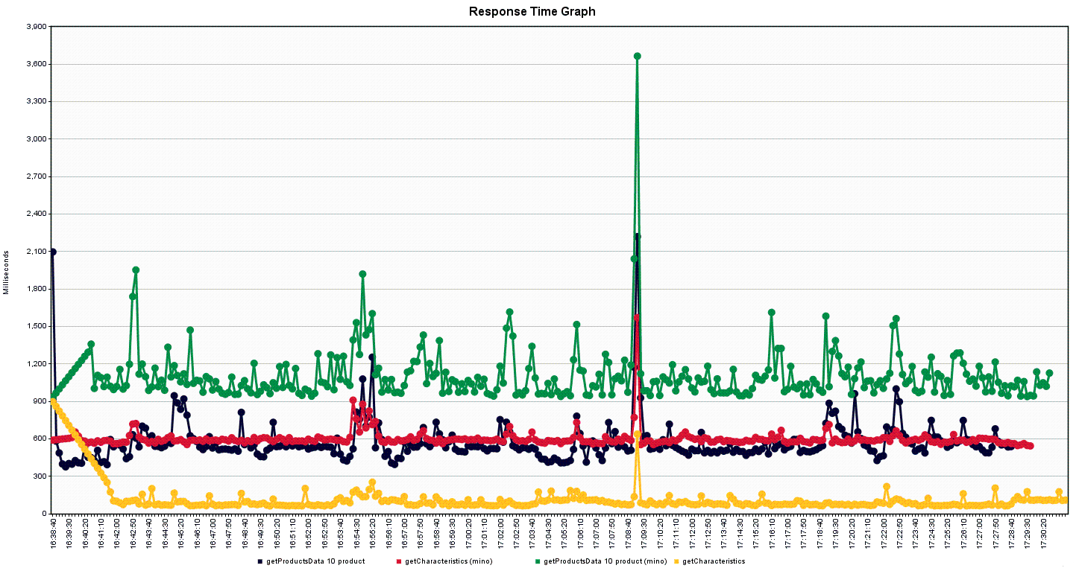
Products micro-service
Notes:
Ref photo

Slide 32
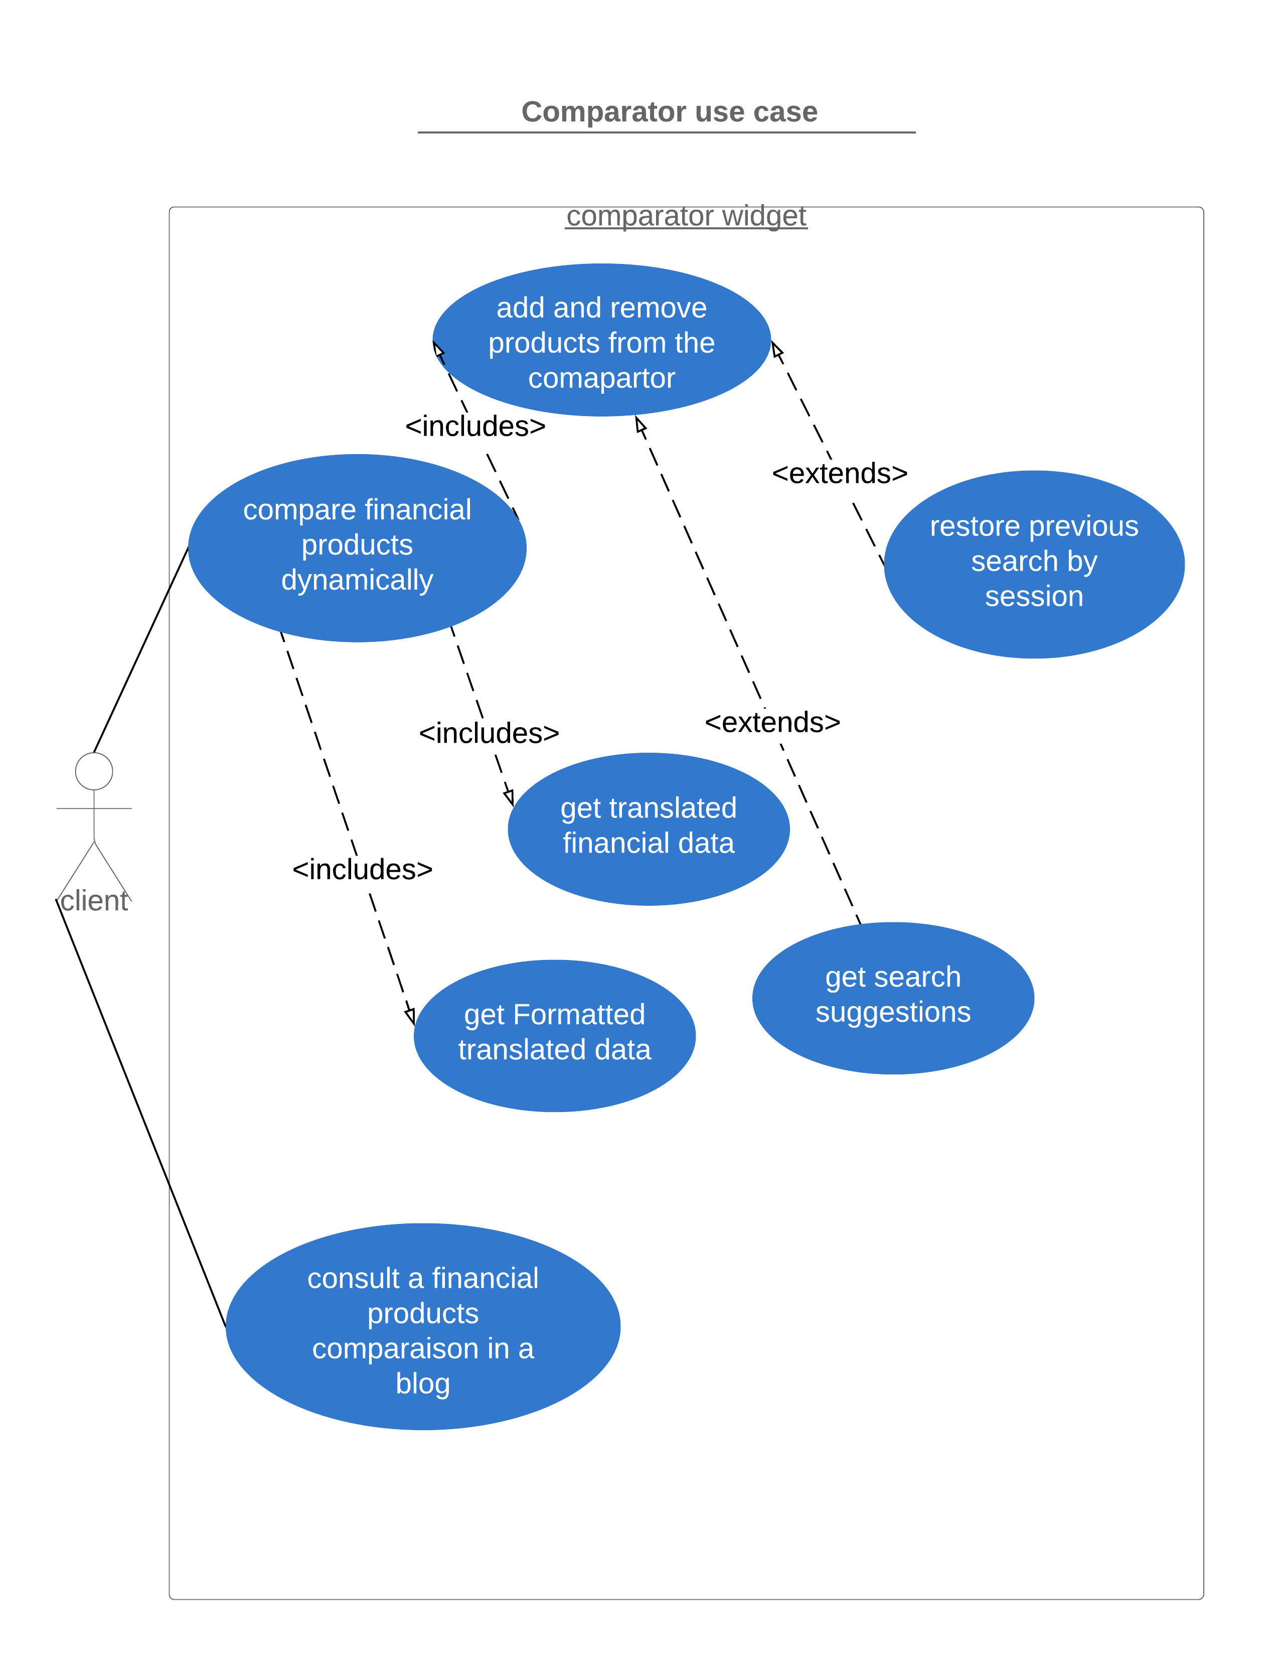
Comparator widget
Notes:
Ref photo

Slide 33
Comparator widget
Use case
Non functional requirements
Relaisation
Notes:
Ref photo

Slide 34
Comparator widget
Browsers
Support
number of requests
Non Functional requirements
File size
Configuration
Notes:
Ref photo

Slide 35
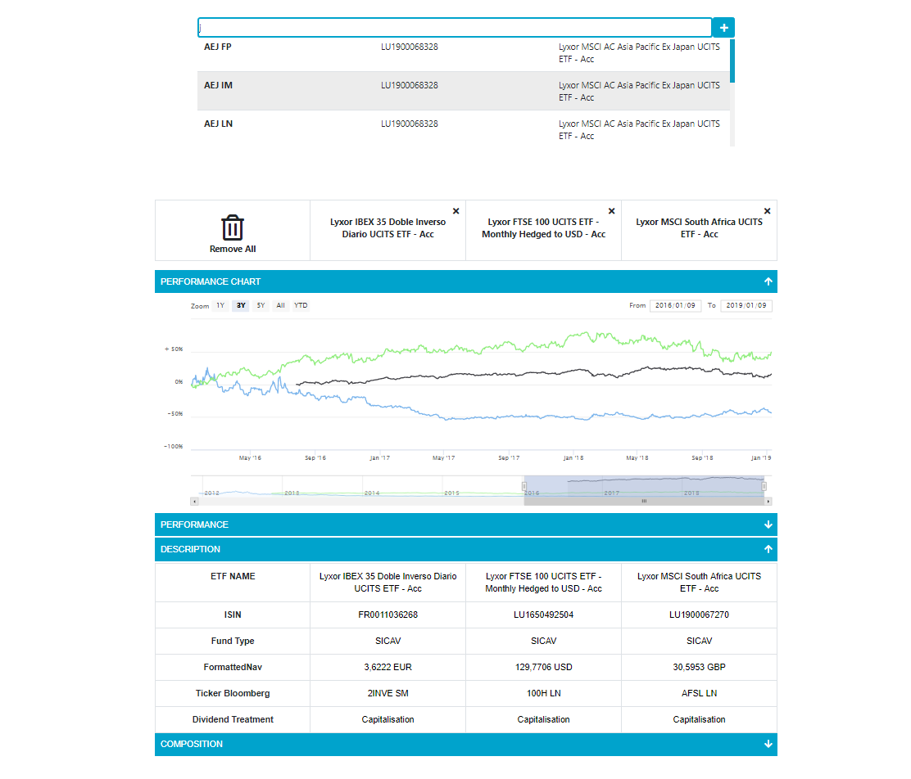
Comparator widget
Comparator widget in the dynamic mode
Notes:
Ref photo

Slide 36
Integration - Translate API
Translate API use case
Translate API non functional requirements
Translate API realisation
Smart table widget use case
Notes:
Ref photo

Slide 37

Integration - Translate API
Translate-API use case
Translate the words and phrases based on provided input
Add / update translations
Client
Notes:
Ref photo

Slide 38
Integration - Translate API
Rapid Responses
Robust
Non Functional requirements
Configuration
Notes:
Ref photo

Slide 39
Integration - Translate API
Old translate API performance statistics
New translate API performance statistics
Threads : 500
Number of requests per thread : 10
Input size : 50 keywords
0,5 s between threads
Notes:
Ref photo

Slide 40

Integration - smart table
Smart table use case
Create a link to route to the product detailed page
<<include>>
Display financial products data
Format data based on a provided context
<<include>>
<<include>>
Client
Translate data
Notes:
Ref photo

Slide 41
Demonstration
Logical architecture of the solution
Sequence diagram of the smart table render data case
Demo of the CMS
Notes:
Ref photo

Slide 42
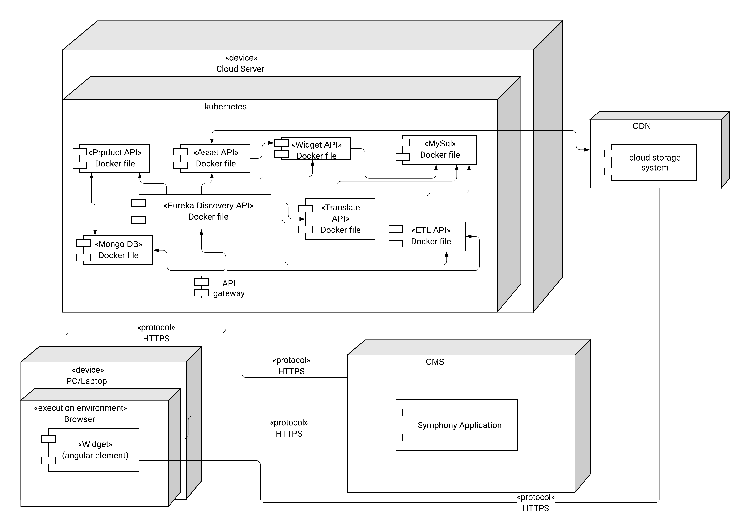
Demonstration
Logical Architecture of the hole solution
Notes:
Ref photo

Slide 43
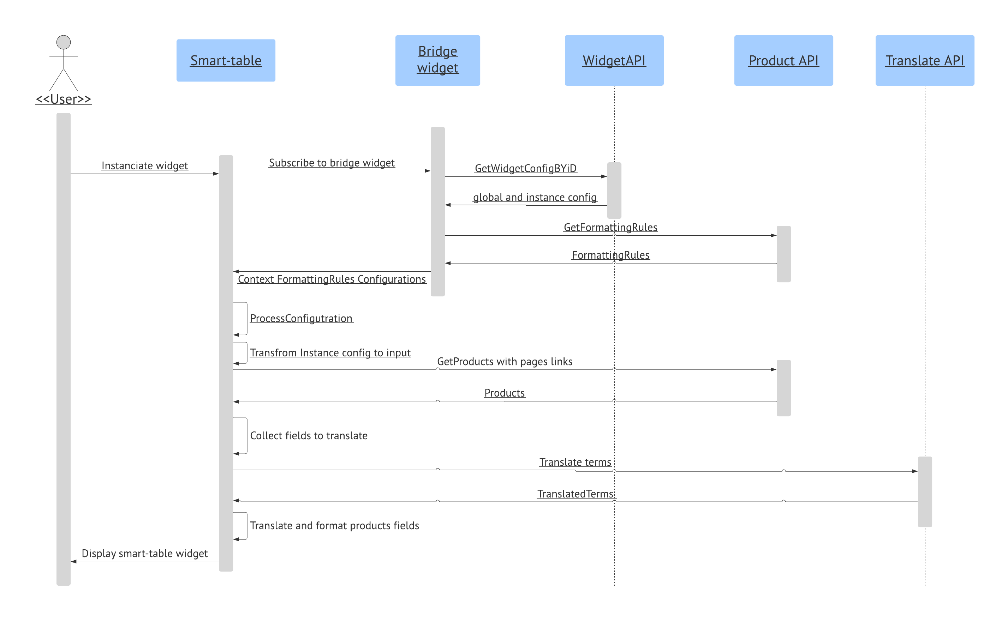
Demonstration
Sequence diagram that explains how the different systems of the solution interact together
Notes:
Ref photo

Slide 44
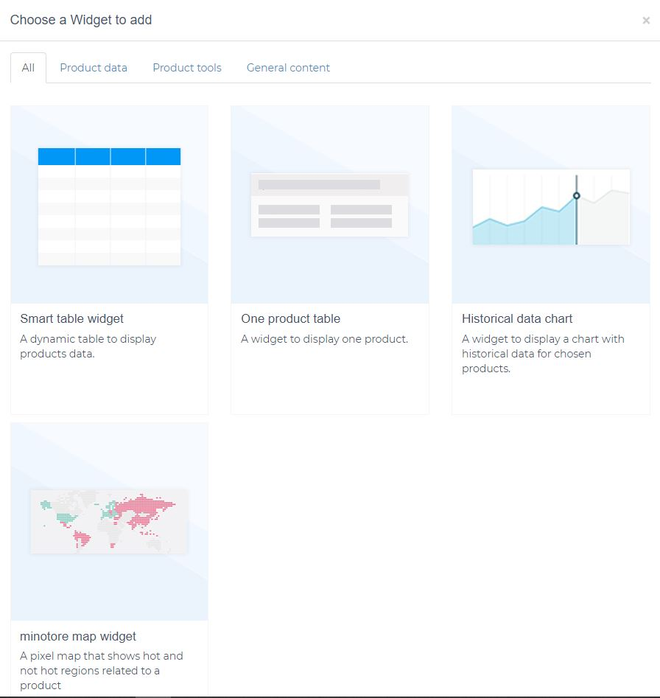
Demonstration
Minotore widgets market
Notes:
Ref photo

Slide 45
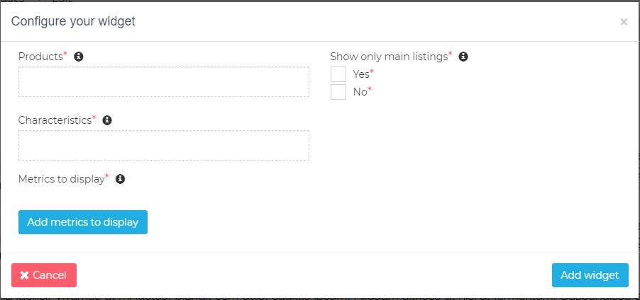
Demonstration
Smart table configuration form
Notes:
Ref photo

Slide 46
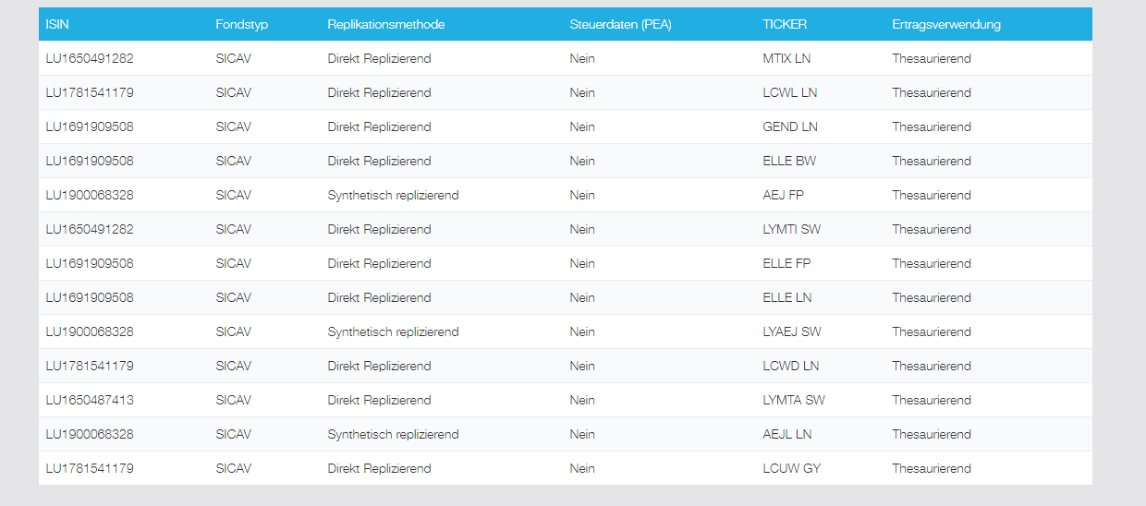
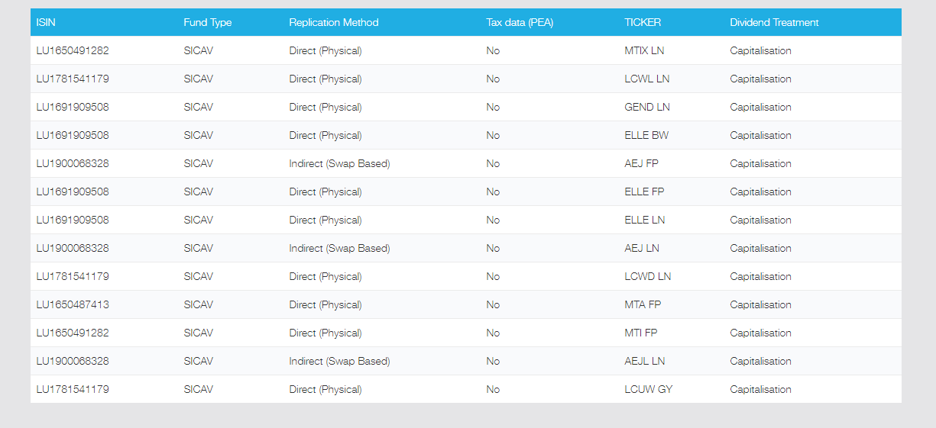
Demonstration
Smart table widget in a German web site
Smart table widget in an English web site
Notes:
Ref photo

Slide 47

Conclusion and perspectives
We have worked as a team to develop strong, and robust micro-services with respect to the code best practices and quality.
Created flexible, configurable and easy to manage widgets.
Updated the current CMS to fit with the new architecture.
Deployed the developed solution.
Notes:
Ref photo

Slide 48

Conclusion and perspectives
Create the content management system that will be responsible for rendering the content created by the CMS.
Create more widgets and expand the Minotore widgets market.
Notes:
Ref photo

Slide 49
References
https://www.datasciencecentral.com/profiles/blogs/10-open-source-etl-tools
https://wikifinancepedia.com/finance/top-10-best-financial-websites-india
https://www.statista.com/statistics/203953/us-market-shares-of-selected-print-imedia-websites/
https://assets.ey.com/content/dam/ey-sites/ey-com/en_gl/topics/wealth-and-asset-management/wealth-asset-management-pdfs/ey-global-wealth-management-research-report-2019.pdf
https://www.bloomberg.com/graphics/2019-asset-management-in-decline/
Notes:
Ref photo

Slide 50
Thank you for your attention
Notes:
Ref photo

